Slide 1
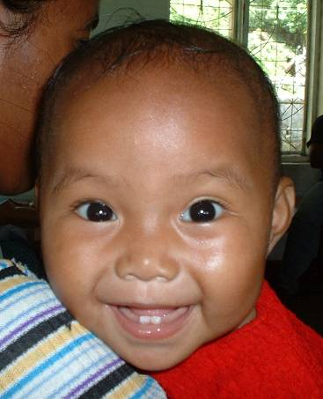
The Reaching Every District (RED) strategy

Slide 2
Reaching Every District: 5 RED Components
Re-establish outreach services
Conduct supportive supervision
Establish community links with service delivery
Monitor and use data for action
Improve planning and management of resources
Notes:
None of these interventions is new. The idea is that these done better and done together can improve services.
As STOP will probably mostly get involved with planning, esp. of outreach services, improving supervisory techniques and improving monitoring and use of data

Slide 3
History of RED strategy
Officially created by WHO African regional office (WHO-AFRO) in early 2000s
Created in response to stagnant immunization performance in the African region
A focus on national coverage was masking the variation sub-national coverage i.e. many districts had less than 80% immunization coverage
Most immunization programs had the most basic elements: human resources, facilities, vaccine supply chain and money
These programs had reached the “easy to reach” children but now needed to reach the “hard to reach” children
Objective
To reach the “hard to reach”, needed to address the identified challenges with a package of strategies:
Improve planning and resource management, monitor the program better, use monitoring data better, improve links with all communities, improve availability of immunization services in hard to reach communities (outreach)

Slide 4
Disclaimer…
RED focuses on district-level results
Traditionally too much focus on national results
Importance of decentralization
Identification of and improvement in poorly performing districts critical to reduce outbreaks
Really want to reach every:
Village or health center catchment area
Child

Slide 5
Matching RED strategies to barriers
 | Poor access | High dropout/ poor utilization | Missed Oppor- tunities | Manage-ment | Community barriers
Notes:
Here is an example of how managers might choose to emphasize certain components of the RED strategy to address certain barriers. Some of these are indicators that may reflect problems with one or more barriers at different levels in the EPI program. For example, outreach and data…

Slide 6
Matching RED strategies to barriers
 | Poor access | High dropout/ poor utilization | Missed Oppor- tunities | Manage-ment | Community barriers
 | +++ | ++ | + | + | ++
 | + | + | ++ | ++ | +
 | + | + | + |  | +++
 | + | +++ | +++ | ++ | +
 | + | + | + | +++ | +
Notes:
Here is an example of how managers might choose to emphasize certain components of the RED strategy to address certain barriers. Some of these are indicators that may reflect problems with one or more barriers at different levels in the EPI program. For example, outreach and data…

Slide 7
Matching RED strategies to barriers
 | Poor access | High dropout/ poor utilization | Missed Oppor- tunities | Manage-ment | Community barriers
Outreach | +++ | ++ | + | + | ++
Supportive supervision | + | + | ++ | ++ | +
Community links | + | + | + |  | +++
Monitoring, use of data | + | +++ | +++ | ++ | +
Resource management | + | + | + | +++ | +
Notes:
Here is an example of how managers might choose to emphasize certain components of the RED strategy to address certain barriers. Some of these are indicators that may reflect problems with one or more barriers at different levels in the EPI program. For example, outreach and data…

Slide 8
1) Re-establish Outreach Services
Conduct initial analysis to assess status
Make a map in every district and every health facility showing population, communities, roads etc.
Develop session plan showing how every community will be reached regularly
Implement workplan showing activities, persons responsible and timetable, including supervisory visits

Slide 9
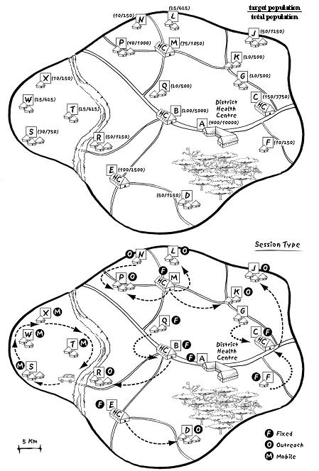
MAKING A DISTRICT MAP
For every health center:
Decide delivery strategy for each village:
fixed, outreach, mobile team

Slide 10
Session Plan - reach each village regularly
Notes:
Outreach is an expensive intervention. Takes time to plan, to implement and takes resources. Where there are vehicles, they complain of too few people, where have a motorcycle, complain need a vehicle, where have a bike, complain that need a motorcycle. And some are on foot.
Respecting this program is now considered on of the key barriers to increasing coverage. Many don’t set a schedule, or set a date but do not show up. Mothers get discouraged and do not take the day off the next time.

Slide 11
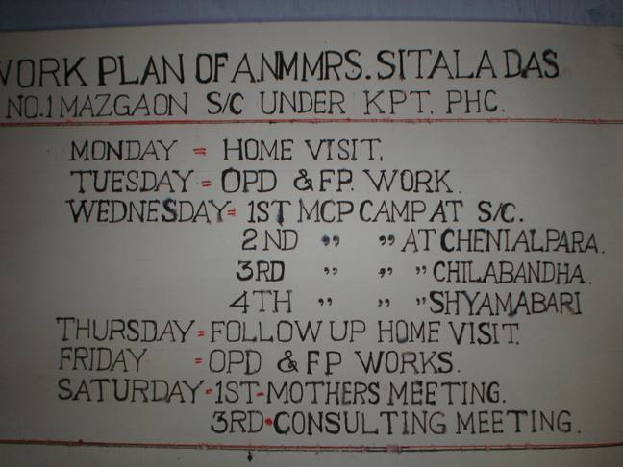
Clinic Fixed and Outreach plan

Slide 12
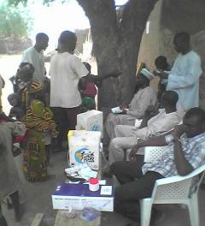
Outreach Challenges
Cost/Logistics
Per diem
Transport
Cold chain
Access
Organization
Low return (few children)
Frequency
Need at least monthly to match schedule
Missed sessions

Slide 13
2) Conduct Supportive Supervision
Supervision that combines on-site training, problem solving, and monitoring
Focus on priority issues for follow-up at district and health facility level:
map
session plan
workplan
monitoring chart
stock/supply records
deciding on corrective action for the quarter
Supportive Supervision is more than just a check-list
Notes:
Work with counterparts to discuss barriers and how to overcome, e.g. monthly meetings, written feedback or bulletins

Slide 14
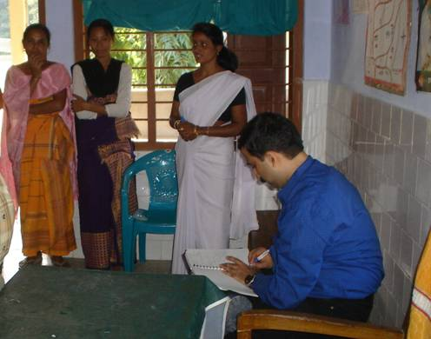
Supportive Supervision Challenges
Resources
Staff
Time
Per diem
Transport and fuel
Organization
Frequency

Slide 15
3) Establish Community Links
Assist with organization of services
Planning convenient services
Session volunteers, informing mothers and crowd control
Defaulter tracing
Vaccine transport
Community attitudes
Father’s permission
Who else influences mothers’ decision making
Who else can facilitate vaccination?
Notes:
Different countries define community and links differently. Find out how it is approached where you are.
Among community issues there are attitudes of influential people. Father may forbid the mother to take the child – why need to go back a 4th time. Mother may have no way to walk 5 km with baby and older siblings. If someone would watch after the older. Mother-in-law, head man, religious leader or other elder may be the people who tell the mother what she can and cannot do.
On the flip side, the community can play a helpful role in organizing services. May provide the outreach site, may round up mothers, may help in defaulter tracing, may help in vaccine transport.

Slide 16
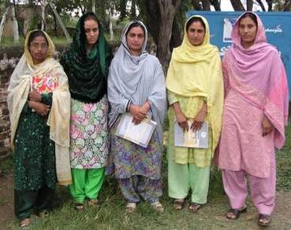
Community Links: Lady Health Workers in Pakistan
Duties:
birth registration
defaulter follow-up
‘catch-up’ routine immunization (including TT)

Slide 17
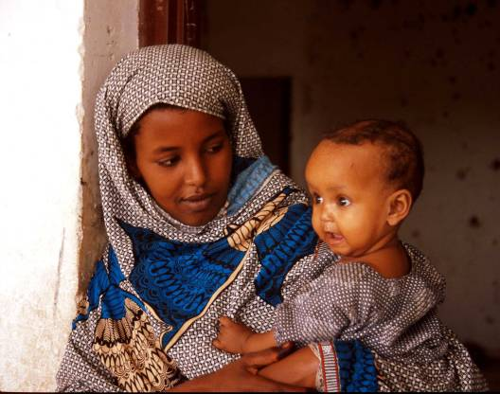
Community Links - Challenges
Attitudes
Community
Health Staff
Language
Organization
Notes:
Of reasons sited for incomplete vaccination in Burkina Faso in 2003, 6 of the top ten were because the mother lacked the information, or had some other personal barrier that might have been addressable. The other 4 were service delivery problems that should not have impeded eventual delivery of the vaccine.

Slide 18
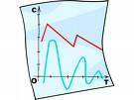
4) Monitor and Use Data for Action
Compile data
Analyze data to identify problems
Decide what activities needed to solve problems: existing resources or extra resources
Go back to your work plan and add these activities, prioritize
Monitor and evaluate impact
Topic of another talk…
Notes:
There is a whole additional talk that focuses on this, so will not dwell here.

Slide 19
5) Planning and Management of Resources
Ensure effective use of human, financial and material resources
Development of national, provincial, and district POA/work plans
Capacity building of staff
Systematic vaccine forecasting, supply and distribution
Effective management of the cold chain
Mobilization of resources

Slide 20
RED Guides
The AFRO Reaching Every District Guidelines
The AFRO RED microplanning guidelines

