Slide 1
Orientation to Routine Immunization Systems
An overview of routine immunization services in developing countries

Slide 2
Presentation I Outline
Broad overview of Routine Immunization (RI)
History of Expanded Program on Immunization (EPI)
About the RI vaccines
About the RI system
Global strategies to strengthen RI
Common problems of RI services

Slide 3
About routine and supplementary immunization activities
Routine Immunization (RI)
Supplementary Immunization (SIA)
Objective: Provide all vaccinations listed on country RI schedule
Services are provided on an ongoing basis from permanent locations
Timing: throughout the year
Target: Usually <1 year olds
Objective: Provide specific vaccines to those who missed receiving them in RI or who did not seroconvert when receiving RI
SIAs provided from multiple permanent and temporary locations
Timing: short duration (1 week)
Target: Usually <5 or <15 year olds
Other names: campaigns, SIAs, NIDs (National Immunization days), SNIDs (sub-national immunization days)

Slide 4
Brief History of Global Immunization Systems
1974: Expanded Program on Immunization (EPI) officially created
6 basic antigens for infants:
  Tuberculosis (BCG)
  Polio
  Diphtheria, tetanus, pertussis (DTP)
  Measles
1990: Polio eradication goal globally endorsed
2000: GAVI Alliance created to streamline investment, vaccine introduction
2001: Reaching Every District (RED) strategy created to revitalize stagnating RI performance
2003: Global Immunization Vision & Strategy (GIVS) framework published to unify partners around common strategies and performance goals for immunization services

Slide 5
Global Goals for RI
Outlined in the Global Immunization Vision & Strategy Framework 2006 – 2015 and the Global Vaccine Action Plan 2011-2020
Outcome goals
  National immunization coverage >90% by 2015
  District immunization coverage >80% by 2015
  Decrease in VPD disease incidence by 2/3rd by 2015 from 1990 levels
  Eradicate polio

Slide 6
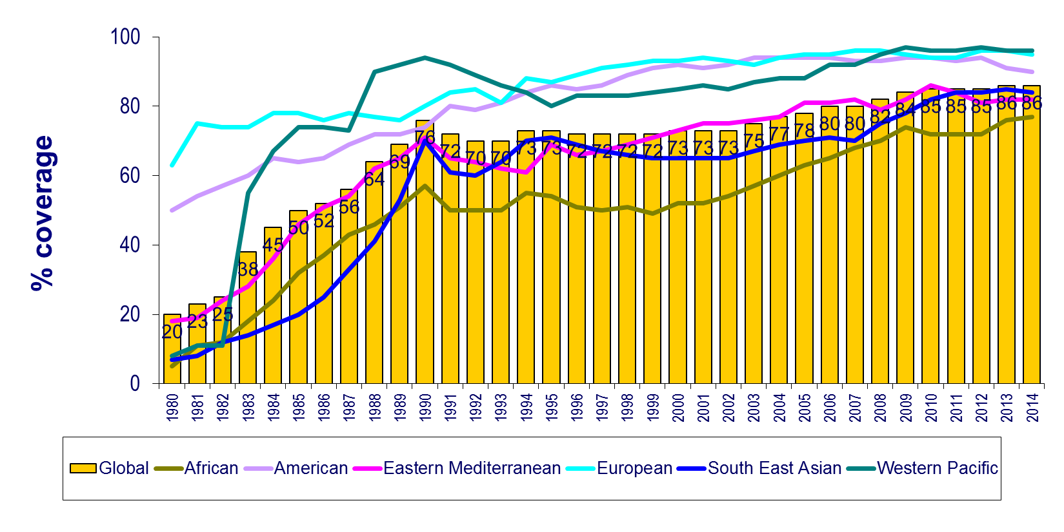
Global Immunization 1980-2014, DTP3 coverage
global coverage at 86% in 2014
Source: WHO/UNICEF coverage estimates 2014 revision. July 2015
Immunization Vaccines and Biologicals, (IVB), World Health Organization.
194 WHO Member States. Date of slide: 21 July 2015.

Slide 7
Estimated Global Annual Vaccine-Preventable Disease (VPD) Deaths Averted and Still Occurring among Children <5 Years, 2004
2.5mil deaths
2.5mil deaths averted
WHO, Burden of Disease 2004, released 2008
*vaccine preventable component caused by Streptococcus pneumoniae, Haemophilus influenzae type b,
JE^, Japanese Encephalitis
Notes:
As shown by the blue bars in this slide, in 2004, basic immunizations were estimated to annually prevent over 2.5 million child deaths, primarily due to measles, pertussis, and tetanus. Vaccines also prevent severe morbidity from other devastating diseases, such as polio, for millions more children.
However, immunization has the potential to do much more. The red bars show that another 2.5 million deaths still occur which could be prevented by vaccines. While immunization cannot prevent all pneumonia and diarrhea deaths, vaccines have recently become available to combat significant proportions of these major causes of child mortality.
Introducing a portfolio of newly available but under-utilized vaccines into routine immunization programs in low income countries between now and 2015 is estimated to result in a cumulative total of 4.2 million future deaths being prevented.

Slide 8
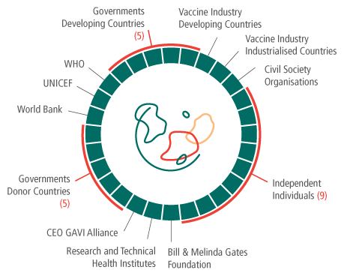

Global Alliance for Vaccines and Immunization (GAVI Alliance)
Objectives
Accelerate access to existing underused vaccines
Strengthen health and immunization systems in countries
Introduce innovative new immunization technology, including vaccines
www.vaccinealliance.org
Numbers reflect seats on the GAVI Alliance Board of Directors
Notes:
To address gaps in EPI and further realize the potential for immunization, multiple partners formed the Global Alliance for Vaccines and Immunization (GAVI Alliance) in 2000.
With funding from the Bill and Melinda Gates Foundation and multiple donor countries, this public-private partnership seeks to provide funding to low income countries to introduce underutilized vaccines, to strengthen immunization systems, and to introduce new technologies.

Slide 9
About THE Vaccines

Slide 10
The Routine Vaccines
Bacille Calmette-Guérin (BCG) [against tuberculosis]
Oral Polio vaccine (OPV)
Inactivated Polio Vaccine (IPV)
Diptheria, tetanus, pertussis (DTP or DTC or DTaP)
Hepatitis B vaccine (HepB or HBV)
Haemophilus Influenzae type B vaccine (Hib)
Measles containing vaccine (MCV)
Rubella
Pneumococcal conjugate vaccine (PCV)
Rotavirus vaccine (RV)
Human Papillomavirus vaccine (HPV)
Recommendations for children residing in certain regions
  Yellow Fever vaccine (YF)
  Japanese Encephalitis vaccine (JE)
  Meningococcal A Conjugate vaccine (MAC, MenAfriVac)

Slide 11
How Vaccines Are Packaged
Certain antigens usually presented as combination vaccines
  MR vaccine = measles and rubella
  Pentavalent vaccine = diptheria, tetanus, pertussis, HepB, Hib
Most vaccines packaged as multi-dose vials
  Measles vaccine vial = 10-dose, 5-dose, 1-dose
  Polio vaccine vial = 20-dose, 10-dose
  Pentavalent vaccine vial = 10-dose
Certain vaccines are freeze-dried and require reconstitution upon use
  Measles, BCG, Yellow Fever and certain Hib formulations
  Once reconstituted, can only be used for 8 hours
  Vaccines not requiring reconstitution can be used up to 30 days after vial is opened

Slide 12
WHO-Recommended#
Routine Immunizations & Immunization Schedule
Age | Traditional Vaccines | Hepatitis B Vaccine 1 or 2 |  | H. Influenzae | Newer vaccines
Birth | BCG, OPV0 | HepB1
6 weeks | DTP1, OPV1 | HepB2 | HepB1 | Hib1 | PCV1, RV1*
10 weeks | DTP2, OPV2 |  | HepB2 | Hib2 | PCV2, RV2*
14 weeks | DTP3, OPV3 | HepB3 | HepB3 | Hib3 | PCV3, RV3*
9 or 12 months | Measles, Rubella (YF and JE**)
9-13 years |  |  |  |  | HPV1-3***
#See WHO recommendation summary tables: http://www.who.int/immunization/policy/immunization_tables/en/index.html
* doses required for Rotarix; 2 doses required for Rota Teq
**Yellow fever and JE vaccine are given to children residing in certain regions
***HPV-quadrivalent requires 3 doses; 2nd dose given 2 months after 1st and 3rd dose given 4 months after 2nd dose.

Slide 13
Schedules Do Vary By Country
Age | Bangladesh | Kenya | Haiti
Birth | BCG | BCG, OPV0 | BCG, OPV0
6 weeks | Penta1, OPV1 | Penta1, OPV1, PCV1 | DTP1, OPV1
10 weeks | Penta2, OPV2 | Penta2, OPV2, PCV2 | DTP2, OPV2
14 weeks | Penta3, OPV3 | Penta3, OPV3, PCV3 | DTP3, OPV3
36 weeks | OPV4, Measles
9 months |  | Measles, Yellow Fever | Measles-Rubella
Source: WHO immunization schedule database, October 2011
http://www.who.int/immunization_monitoring/en/globalsummary/scheduleselect.cfm

Slide 14
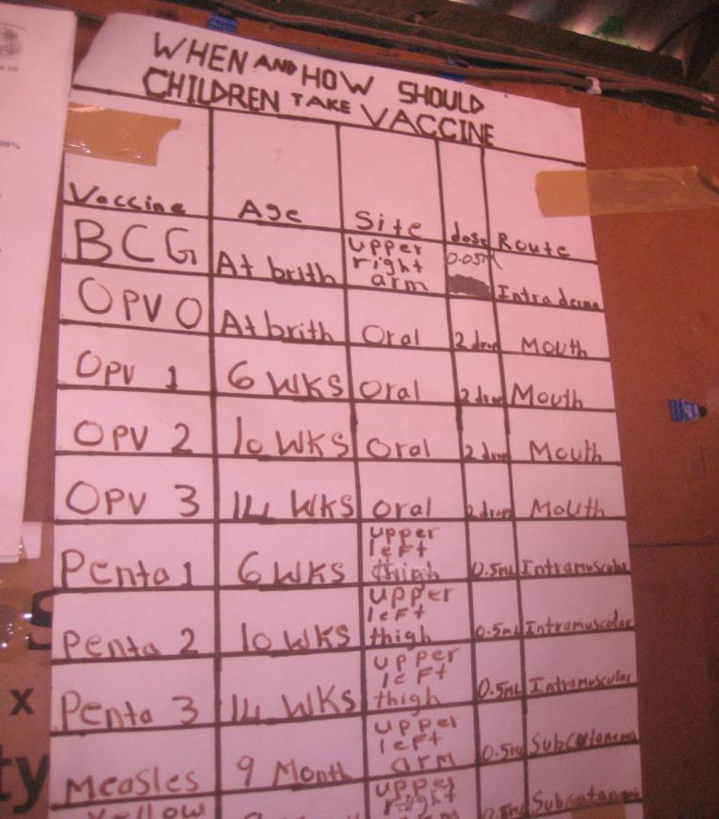
Example: Vaccination Schedule Poster

Slide 15
About Country RI Guidelines & Policies
Countries often have an EPI policy and implementation document
Common policies include
  The immunization schedule
  The eligible age of vaccination per vaccine
  How a vaccinator should administer vaccinations (e.g. dosage, route, site of administration)
  Which staff are allowed to administer vaccinations
  Storage of vaccines, use of opened vials
  Contraindications to vaccination
  How to respond to adverse events following immunization
  Cold chain maintenance
  Recording and reporting practices
  How to conduct social mobilization to mothers, local leaders and key stakeholders
  Responsibilities of each administrative level / staff member
  Key methods for providing immunization services

Slide 16
About the RI System

Slide 17
RI System Components
The Immunization System Environment
External
Environment
Health System
Immunization System
The Routine Immunization System
Finance
Planning & Management
Human Resources
&
Capacity Building
Immunization Service Delivery
Communications & Community Links
Vaccine Supply & Quality
Cold Chain & Logistics
Surveillance
Monitoring & Using Data for Action (Response)

Slide 18
HUMAN RESOURCES & CAPACITY BUILDING

Slide 19
Human Resources: The EPI staff
National level
  Ministry of Health immunization team
    Led by EPI manager
  Major immunization partners
    World Health Organization: EPI team lead by EPI focal point
    UNICEF: Maternal & Child health team with EPI focal point
Region/district levels
  Government immunization focal point / manager
    manage district-wide operations including RI
Facility level
  Facility medical officer-in-charge (MOIC, OIC, IC)
    Oversee reporting process, approves expenses, supervises health workers
    Usually is VPD surveillance focal point
  Health worker or vaccinator
    Provides vaccinations
    Completes monthly reports, immunization register
    Tracks immunization performance via monitoring charts, other monitoring tools
Routine & supplementary activities are often managed by same staff (e.g. EPI = all immunization activities in the country)

Slide 20
Example: Human Resources for Immunization in Liberia
Ministry of Health
  12 person team: team lead, surveillance officers, communication officers, data managers, SIA and RI focal points
  County health team: staff member assigned as EPI focal point
  Facility officer-in-charge: responsible for facility surveillance
  Facility vaccinator: provides vaccinations, monitors service performance, mobilizes mothers
World Health Organization
  Heavily support VPD surveillance system financially and managerially
  Support all all other aspects of Liberia’s EPI
  10 person team: team lead, surveillance officers, communication officers, data managers, SIA and RI focal points
UNICEF
  Immunization work conducted by Maternal and child health team
  Responsible for procurement of all EPI vaccines for country
Multiple NGOs
  Conduct district-level supervision
  Provide funding for many RI expenses (vehicles, fuel)
USAID
  Provides majority of WHO immunization budget

Slide 21
Planning & Management

Slide 22
Immunization Action Plans
Action plans exist at all administrative levels
  National plans known as comprehensive multi-year plans (CMYPs)
    Include coverage goal, major program changes (vaccine introduction), new strategies to reach goal
    Often used to procure financing from external sources
    created every 5-10 years
  District, facility level plans known as microplans
    District plans used to consolidate information on facilities (target information, vaccine needs, expected performance)
    Facility plans used to identify when, where and how to hold immunization sessions throughout facility catchment area
    updated multiple times per year
Country national plans can be found at:
  http://www.who.int/immunization_financing/countries/en/

Slide 23
About facility & district microplans
Microplans commonly include
  Catchment target population
  Vaccine forecast information
  List of villages with population data and session type
  List of planned and held outreach sessions and applicable villages
  Map with distances, hard to reach areas, villages and their populations, outreach sites
  Social mobilization activities

Slide 24
Example facility microplan from India
Notes:
Outreach is an expensive intervention. Takes time to plan, to implement and takes resources. Where there are vehicles, they complain of too few people, where have a motorcycle, complain need a vehicle, where have a bike, complain that need a motorcycle. And some are on foot.
Respecting this program is now considered on of the key barriers to increasing coverage. Many don’t set a schedule, or set a date but do not show up. Mothers get discouraged and do not take the day off the next time.

Slide 25
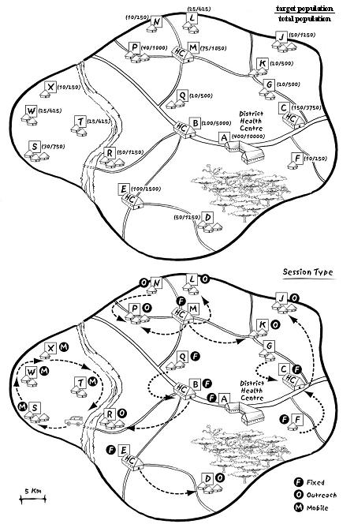
Planning: Catchment Area Map
Catchment area: service delivery area assigned to facility
Maps are created by vaccinators and district focal points
Maps info includes
Health facility location
Village locations, population, distance from HF
Session type for village
Cold chain storage points
Major area barriers

Slide 26
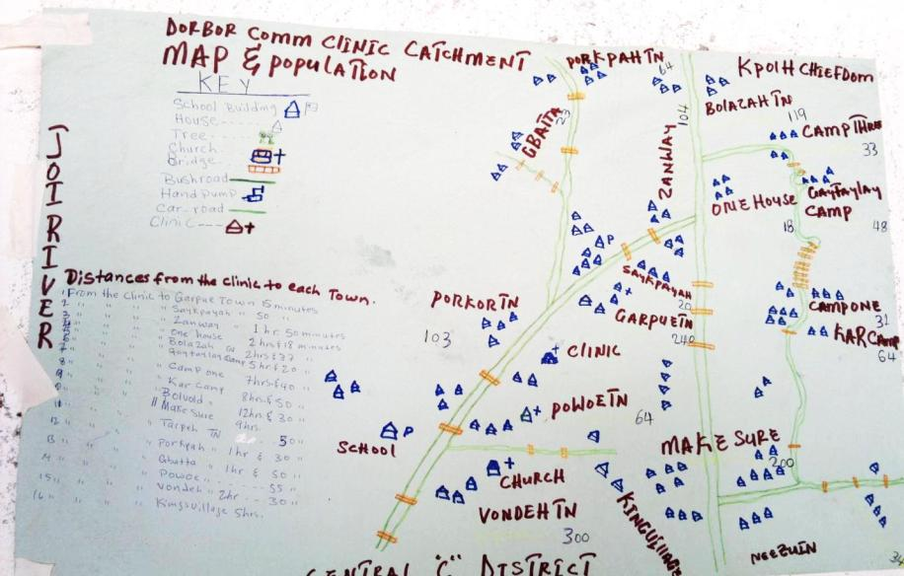
Example: Catchment map from Sierra Leone

Slide 27
Planning: Target population
Target population defined as
  Portion of population which should receive all vaccines listed in country’s immunization schedule
Target population set by the country’s immunization policy
  EPI target age group often is children <1 of age
Target population source usually from census data
  Some locations may conduct local headcounts when census data is considered inaccurate
Population numbers are given to district, facility health staff to use for
  ordering vaccines, monitoring program performance and planning sessions

Slide 28
Managing RI services: Supervision
Supervision is a common national and district activity to ensure RI services are functioning
Supervision objective
  Provide constructive feedback to facility staff on performance and help remedy problems
  Supervisor commonly uses a checklist to cover all aspects of EPI
District to facility supervision
  District EPI focal point visits facility EPI staff every few months
  District may also hold monthly meetings of facility staff at district capital
National to district supervision
  National level staff from MoH, partners (WHO, UNICEF) visit district health teams
Feedback to supervisee
  Written in a supervisory ledger or just verbal
  Copy of supervisory checklist results may be left with vaccinator
  Feedback is followed up in next visit

Slide 29
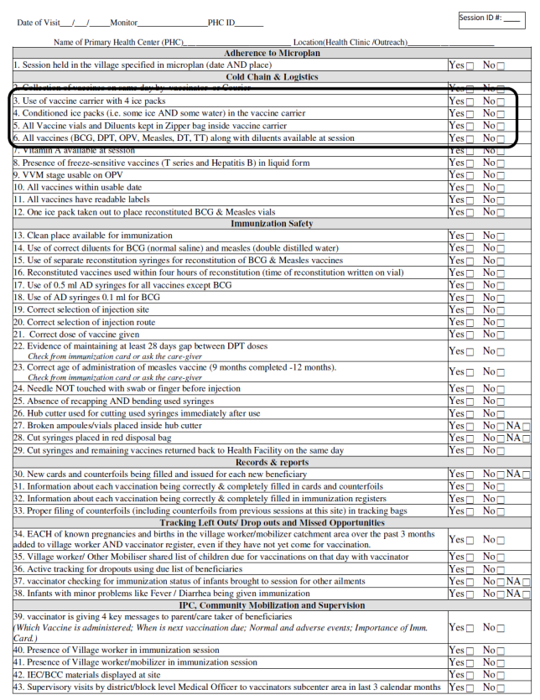
Supervision checklist often used to guide the supervision visit

Slide 30
Cold Chain & Logistics
Cold chain, Injection safety, waste management, vaccine management

Slide 31
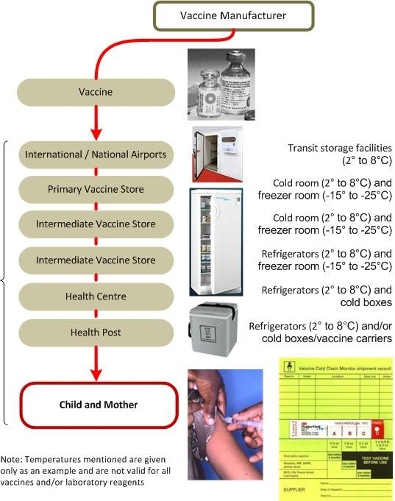
The Cold Chain is EPI’s supply chain for vaccines
UNICEF country office
UNICEF supply division
Country Ministry of Health
The EPI supply chain also transports safety boxes, syringes

Slide 32
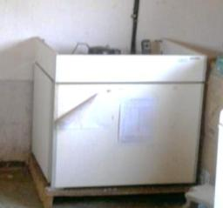
Cold Chain Equipment (I)
Freezers (-15 to -25 degrees C)
  Used for freezing ice packs at facility, district levels
  Used to store some vaccines at national level
Refrigerators (usually w/freezer)
  Used for vaccine storage at all levels
  Power can be from
    Electricity
      Generators/ Voltage Stabilizers required
    Kerosene
    LP Gas
    Solar
Notes:
What do you see most often in the field. Rules for refrigerators. More information can be found in the STOP binder, cold chain section, in Immunization Essentials, chapt. 6 and in Immunization in Practice on your resource CD

Slide 33
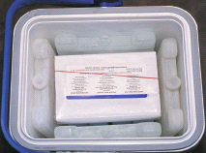
Cold Chain Equipment (II)
Vaccine carriers
  Commonly used for
    Transporting vaccine and diluents for outreach sessions
    Temporarily holding vaccines on fixed delivery days
  Carriers lined with frozen ice packs
  Vaccines remain viable up to 48 hours in carrier
Ice packs also used during immunization session to keep vials cool
  Ice packs should be “conditioned” prior to this use
  “Conditioned” = Allow ice packs to partially
  melt so vaccine is not directly exposed
  to freezing temperature
Notes:
Like cold boxes, vaccine carriers are insulated containers that, when lined with frozen
ice-packs, keep vaccines and diluents cold during transportation and/or temporary
storage. They are smaller than cold boxes and are easier to carry if walking. But they do
not stay cold as long as a cold box – maximum for 48 hours with the lid closed.
Vaccine carriers are used to transport
vaccines and diluents to outreach sites and
for temporary storage during health facility
immunization sessions. In small health facilities
they are used to bring monthly vaccine supplies
from the district store. Vaccine carriers are also
used to store vaccines when the refrigerator is
out of order or is being defrosted.
Different models of vaccine carriers have
different storage capacities.
A foam pad is a piece of soft foam that fits on top
of the ice-packs in a vaccine carrier. There are some
incisions on it to allow vaccines to be inserted in
the foam. During immunization sessions, the foam
pad serves as a temporary lid to keep unopened
vaccines inside the carrier cool while providing a
surface to hold, protect and keep cool opened vaccine
vials. Previously, ice packs were used to keep
vaccines cool during immunization sessions outside
of vaccine carriers. It is now recommended to
use the supplied foam pads for this purpose.
The type of vaccine carrier a particular health facility needs depends on:
• the type of vaccines and diluents to be transported;
• the number of vaccines and diluent vials, and ice-packs to be carried;
• the cold life required;
• ice-packs compatible with the size of vaccine carrier;
• the means of transport to be used.
Ice packs should be placed around the outside. Cold sensitive vaccines should not be placed in the bottom, as cold air accumulates there. Removing the lid is not as damaging as opening the door of a refrigerator, because of this accumulation of cold air at the bottom.
It takes 24 hours to freeze ice packs.
Directions for packing vaccine carriers.
1 At the beginning of the day of the session, take all the frozen ice-packs you need
from the freezer and close the door.
2 Condition frozen ice-packs properly, by allowing ice-packs to sit at room temperature
until ice begins to melt and water starts to form. You should check
to see if an ice-pack has been conditioned by shaking it and listening for water.
This will prevent freeze-sensitive vaccines from freezing.
3 Put conditioned ice-packs against each of the four sides of the cold box or vaccine
carrier and on the bottom of the cold box if required.
4 Put the vaccines and diluents in the middle of the cold box or carrier.
5 Include a freeze indicator in the packing with the vaccines,
6 In vaccine carriers, place a foam pad on top of the conditioned ice-packs. In cold
boxes, place conditioned ice-packs on top of the vaccines.
7 Close the cold box or carrier lid tightly.

Slide 34
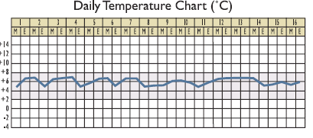
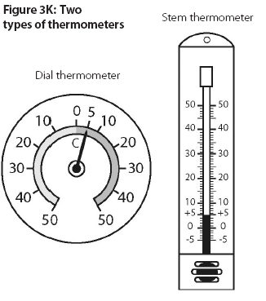
Monitoring cold chain equipment
Twice-daily, everyday recording of temperature for each equipment
Equipment often have multiple thermometers due to malfunction
If temperature outside range, reported to higher levels
Vaccine will be moved if cold chain equipment fails
Notes:
Temperature monitoring cards
Temperature monitoring charts
Shake test
Vaccine Vial Monitors (VVM)

Slide 35
Vaccine Supply & Quality
Cold chain, Injection safety, waste management, vaccine management

Slide 36
Routine Vaccine Forecasting
All levels (facility, district, national) create forecasts of the number of RI doses required for use during a specific time period
Forecasted number used when requesting RI doses from next higher level
Vaccine forecast based on:
  Target population
  Wastage factor based on endorsed vaccine wastage rate
    “Wastage” is any dose not used to vaccinate a targeted person
    Countries set acceptable wastage rates e.g. the proportion of a vial which can be wasted due to various reason
    Measles, BCG, YF forecasts often use rates between 35-50%
    Pentavalent, Polio forecasts often use rates between 10%-30%
    Vaccine wastage factor formula = 100% / (100% – wastage rate)

Slide 37
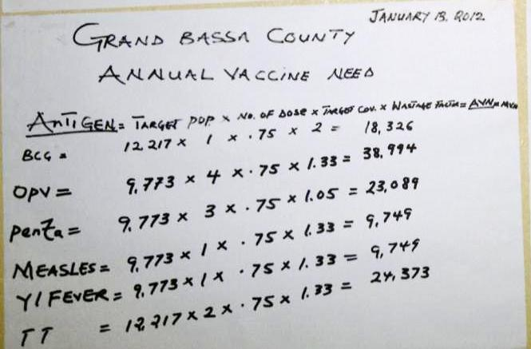
Example: vaccine forecast in Liberia

Slide 38
Practice: Vaccine Forecast
Target population = 1000
Wastage rate = 25%
DTP requires 3 doses per child
Expected coverage = 70%
Doses are supplied every 3 months (1/4 year)
Facility currently has a 300 dose balance
Question 1: How many doses are required for the 3 month period?
Question 2: How many doses should the facility request for the 3 month period?

Slide 39
Managing vaccine supply
Managing vaccine stock (supply) requires tracking stock information
Routine stock management registers used at each administrative level
Registers used to track following info
  Number of vaccine doses received at level
  Number of vaccine doses used at level
  Current balance of doses at level
  Batch numbers, VVM status, expiry date of each vial

Slide 40
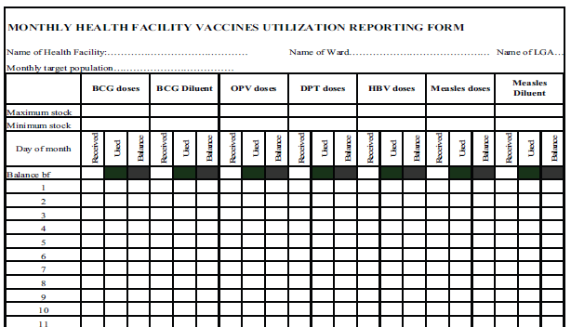
Example: stock management register from Nigeria

Slide 41
Monitoring vaccine quality
Vaccine vial monitors
  Sticker on vial
  Changes color if exposed to heat
Temperature loggers
  Electronic device to monitor actual temperature
  Usually has log of last 30 to 60 days
Freeze Watch Indicator
  Changes color if exposed to freezing temperature
  Not commonly used in most countries
Shake test
  Method to determine if vaccine has been frozen
  Can be time-consuming as requires a suspect vial to be frozen, thawed and then tested
Date of expiry
  Indicated on side on vial

Slide 42
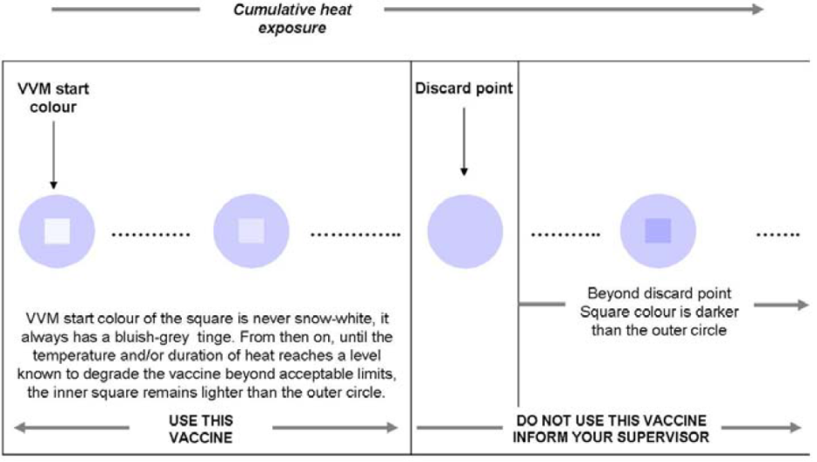
Reading a Vaccine Vial Monitor (VVM)
Notes:
VVMs are used in certain areas of the world, including Asia and Africa. They change color at temperatures specific to the vaccine. For example, a VVM will change color for OPV, the most heat sensitive of vaccines, if a vial is kept at 37 degrees C for 2 days. However, for TT, will change if kept for 30 days at 37 degrees.

Slide 43
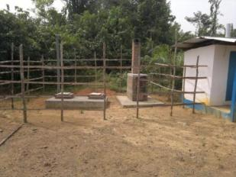
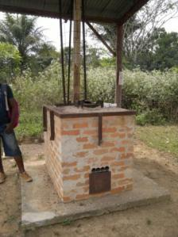
Vaccine Waste Management
Used syringes placed in safety boxes during immunization session
Safety boxes are burned in incinerators or buried in closed or opened pits
Pits/incinerators are ideally fenced for safety

Slide 44
SERVICE DELIVERY: ConducTING IMMUNIZATION SESSIONS

Slide 45
Service delivery methods: Fixed
Fixed immunization sessions
  “Fixed” location = health facility
  Fixed immunization sessions may happen everyday or only specific days each week
  Some vaccines may have special session day
    Most common for Measles and BCG vaccine due to special usage requirement e.g. once vial is opened, can only be used for single day
    Children are “batched” to ensure low wastage of doses in vials

Slide 46
Service delivery methods: Outreach
Outreach immunization sessions
  Sessions which are conducted in communities far from health facility
  Vaccinator usually has multiple outreach locations
  Outreach must be conducted at least 5x per year to each community
  Outreach session schedule
    Includes locations, dates, target population for each planned outreach sessions
  Challenges
    Lack of fuel, transport, poor planning with community

Slide 47
Recording information during sessions
The immunization register
  Used to record beneficiary information:
    Beneficiary name, address, phone, parents’ info, DOB
    Dates when vaccines are received
Tally sheets
  Used to record number of doses administered in an immunization session
    No child information, just number of doses given for each vaccine within a single immunization session
  Tally sheet data is consolidated into monthly reporting forms
Health card
  Beneficiary’s record of vaccination dates
  Used to remind beneficiary when to return

Slide 48
EPI Register Example

Slide 49
Tally Sheet Example

Slide 50
Disease Surveillance

Slide 51
Schematic of surveillance system (1)
Facility level
  Medical staff monitor for suspected diseases
  Surveillance focal point collect surveillance data
  Analyze and use data
  Routinely report to the next level (monthly etc)
District/intermediate level
  Analyze trends and performance
  Use information (identify problem, propose solution, action)
  Routinely report to the next level (monthly etc)

Slide 52
Schematic of surveillance system (2)
National level
  Keep databases
    Immediate / weekly reportable diseases
    Monthly IDS summary report
    Other quarterly reports
    Laboratory (bacteriology, YF, measles & PBMS)
    Case-based (AFP, measles, YF, NNT)
  Monitor surveillance indicators using global standards
    Example: % of cases with specimens collected within 14 days
  Regular detailed analysis and feedback
    Example: Newsletters and feedback to district staff
  Monitor surveillance system reporting
    Timeliness and completeness of reporting at lower levels

Slide 53
COMMUNICATIONS: CREATING COMMUNITY DEMAND FOR RI

Slide 54
RI Communications Strategy
Village structures utilized to mobilize mothers for RI include
  Village health volunteers
  Village chiefs
  Village health committees
  Town criers
Village structures used to support RI system including
  Vaccine transport
  Planning location of outreach services
  Informing mothers of time and location of RI services
  Finding infants who have dropped out of RI services

Slide 55
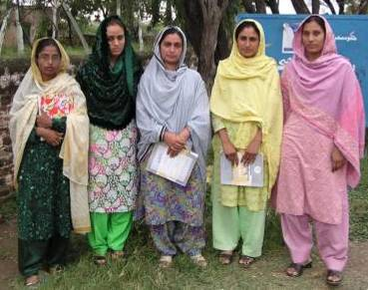
Community Links: Lady Health Workers in Pakistan
Duties:
birth registration
defaulter follow-up
‘catch-up’ routine immunization (including TT)

Slide 56
Key Communications Messages
During a vaccination visit
  When to return for next vaccination
  The potential adverse events that may occur
  Importance of vaccination
During a community meeting
  When and where outreach sessions should/will happen
  When and where fixed sessions happen
  “Special” vaccination days (e.g. for measles, BCG, YF)
  Importance of vaccination

Slide 57
Monitoring & Response: data for action

Slide 58
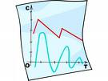
Monitor & Use Data for Action
Compile data
Analyze data to identify problems
Decide what activities needed to solve problems: existing resources or extra resources
Go back to your work plan and add these activities, prioritize
Monitor and evaluate impact
Topic of the next talk (Part II)

Slide 59
Thanks
Questions?

